Slide 1
Digital Portfolio
STUDENT NAME:S.PRIYA
REGISTER NO AND NMID:
DEPARTMENT:
COLLEGE: COLLEGE/ UNIVERSITY

Slide 2
PROJECT TITLE
WEB DEVELOPMENT

Slide 3


AGENDA
Problem Statement
Project Overview
End Users
Tools and Technologies
Portfolio design and Layout
Features and Functionality
Results and Screenshots
Conclusion
Github Link
3/21/2024 Annual Review

Slide 4

PROBLEM STATEMENT
Many businesses and individuals struggle to establish an effective online presence to poorly designed websites,lack of responsiveness,or limited functionality.My projects aim to solve these issues by building modern, user-friendly,and scalable web applications.

Slide 5

PROJECT OVERVIEW
The portfolio is a showcase of my web development work, ranging from static websites to dynamic full-stack applications.each project highlights my ability to design, develope,and deploy solutions that focus on user experience.

Slide 6

WHO ARE THE END USERS?
Small businesses looking for professional websites
Students or learners exploring online resources
General users who expect responsive accessible,and smooth browsing experience

Slide 7

TOOLS AND TECHNIQUES
Frontend:HTML,CSS,JavaScript,React, Tailwind CSS, Bootstrap
Backend:Node .js,Express.js
Database:MongoDB,MySQL
Other Tools:Git, GitHub,VS Code,Figma for UJ/UX, design

Slide 8
PORTFOLIO DESIGN AND LAYOUT
The portfolio itself is designed with a clean , minimal, and responsive layout.It highlights each project through sections such as project cards, descriptions, screenshots, and links to live demos or repositories.
8

Slide 9
FEATURES AND FUNCTIONALITY
Responsive design (mobile-first approach)
Interactive elements (sliders,modals,forms)
Authentication and user management (for some apps)
Optimised performance and accessibility

Slide 10

RESULTS AND SCREENSHOTS
Screenshots of deployed projects are included to visually demonstrate the designs, interface and functionalities implemented.Each screenshot showcases real world usability and design quality
3/21/2024 Annual Review
10

Slide 11
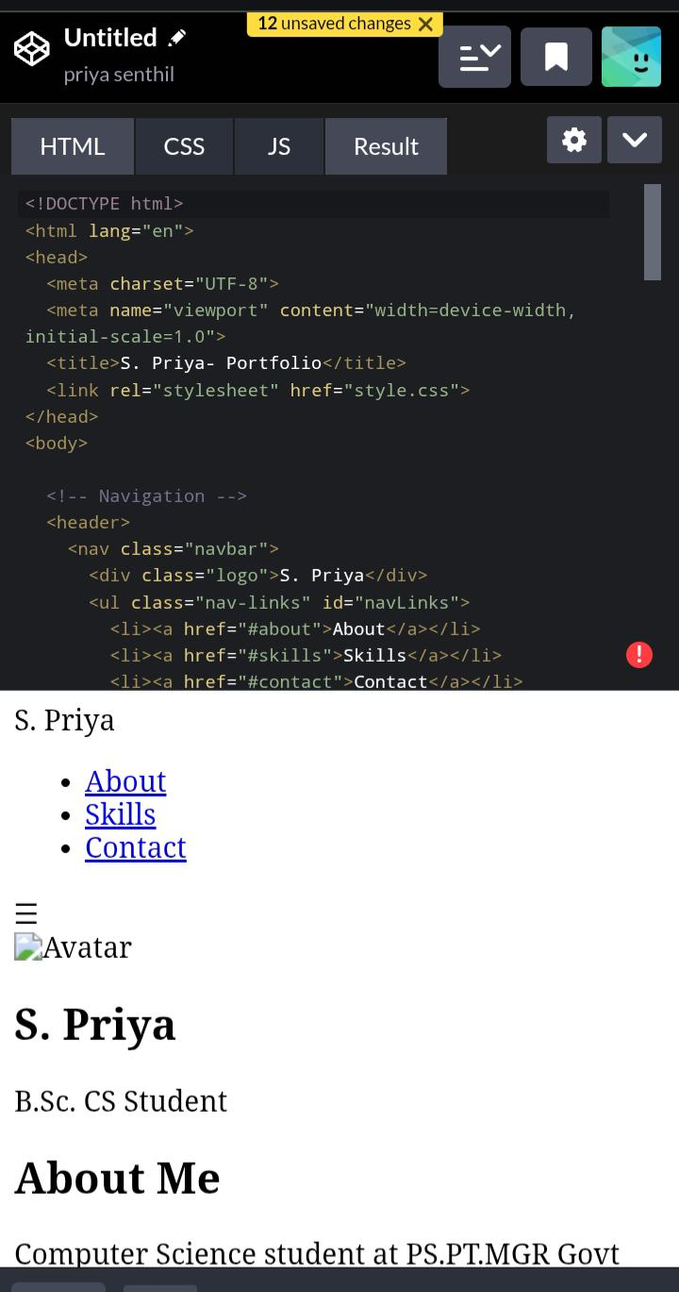
Screen shot

Slide 12
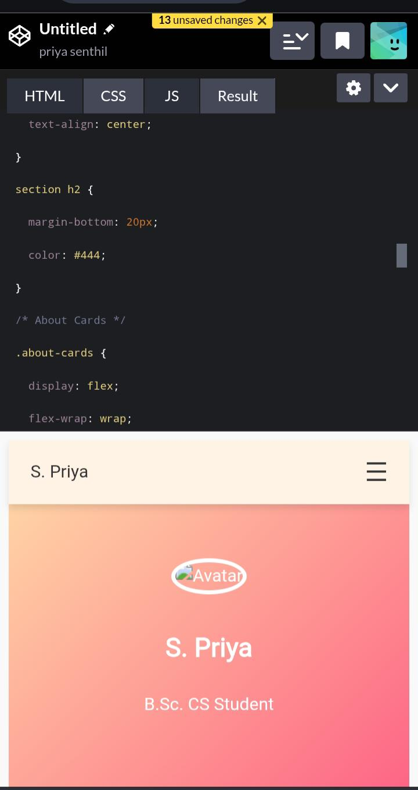
Screen shot

Slide 13
Conclusion
Through these projects,J strengthened my web development skills and gained practical experience in solving real world problems.

